Slide 1
Introduction to Sensory Processing challenges

Slide 2
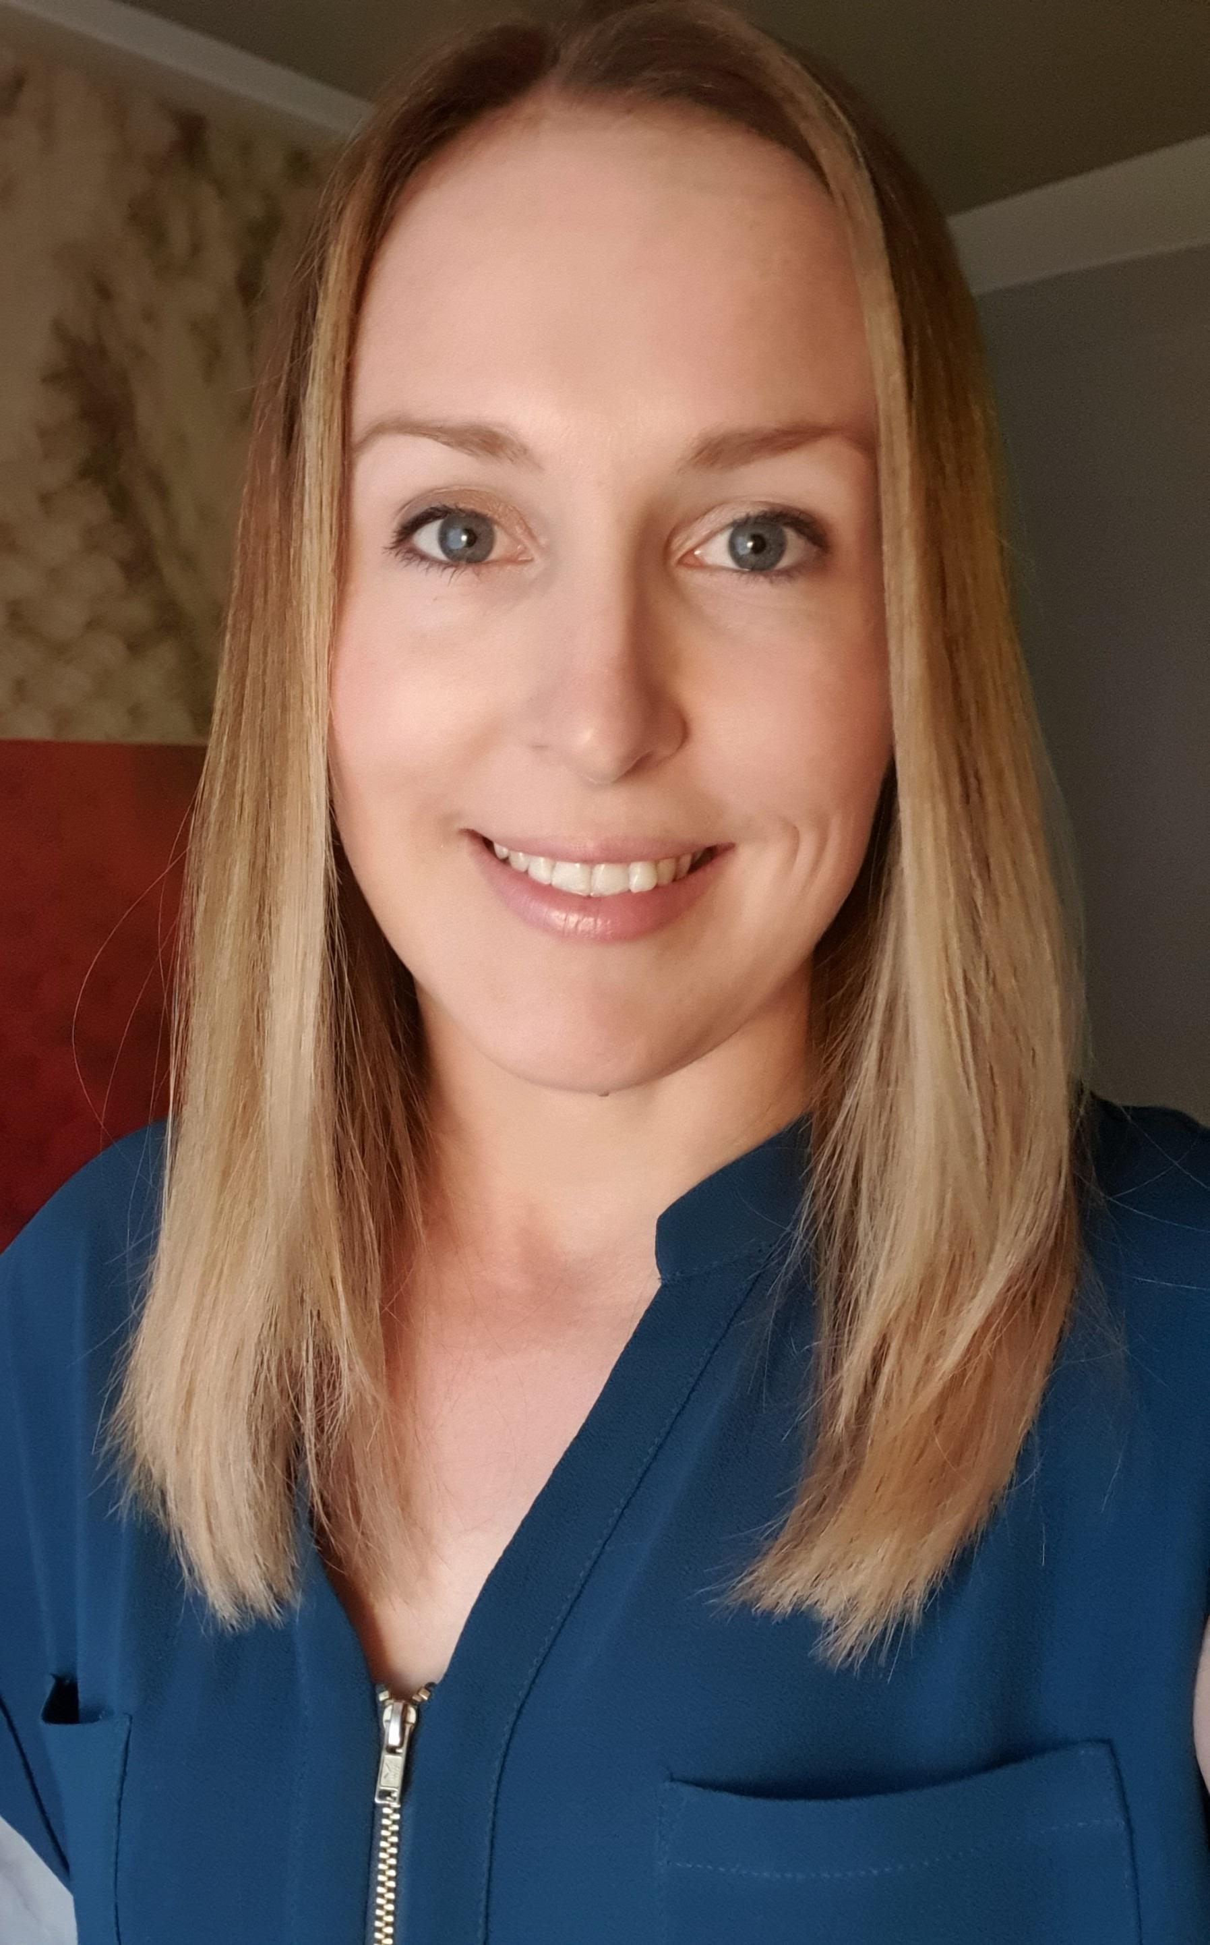
Lucy Griffiths – Lead Occupational Therapist (OT)

Slide 3
Aims
Identify the unknown sensory systems
Explore their impact on function
Discuss support strategies
4. Q & A

Slide 4
Our brains act like air traffic control

Slide 5
The 8 sensory systems
Vision
Hearing (Auditory)
Smell (Olfactory)
Touch (Tactile)
Taste (Gustatory)
Vestibular (Movement)
Proprioception (Body awareness)
Interoception (Homeostasis)

Slide 6
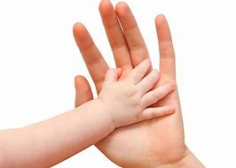
Tactile system- Touch
Receptors in the skin
Help us detect light touch, deep pressure, texture, temperature, vibration and pain
Protect
Discriminate

Slide 7
Behaviours you may see
Hypersensitive
Very distressed by touch
Avoids personal contact with others
Hates wearing clothing and shoes
Hates hair brushing, teeth cleaning, e.t.c
Avoids touching certain fabrics/textures
Limited diet
Under responsive
Clumsy (crashing into objects/people)
Touches everything in sight
Doesn’t respond to pain
May pick/bite their skin
Needs to look at items to correctly identify or manipulate them

Slide 8
Strategies to help
Massage
Lying under a weighted blanket or underneath cushions
Snuggling into a bean bag or sofa
Messy play
Sensory bins – boxes of different textures
Vibrating toothbrush
Warning before physical contact
Timers to increase tolerance
Calming activities before touch

Slide 9
Proprioception system
The sense that enables us to know where our body parts are in space without looking.
Feedback through receptors in joints and muscles.
Underlies our ability to place body parts in a position in space and grade movements. It also aids motor planning and co-ordination of fine and gross motor movements.
It ALSO plays a role in emotional security and confidence as well as calming your body down.

Slide 10
Behaviours you may see
Leans, bumps, trips or crashes into things
Too much/ too light pressure when writing
Seeks deep pressure hugs
Pulls on fingers or cracks knuckles
Bites, kicks or punches others with little known triggers
Constantly chews on things
Self injurious behaviours such as banging head/biting skin

Slide 11
Strategies to help
Rolling a large yoga ball over their body
Deep pressure squeezes alongside body parts e.g fingers, forearms, shoulders
Blowing activities e.g bubbles, feathers, through a straw
Swimming
Wearing a weighted jacket/ backpack or lying/sitting under a weighted blanket
Carrying heavy items e.g backpack
Playdough
Squishy toys
Jumping jacks / animal walks / row row
Trampoline / trampette
Monkey bars in the park
Marching games
Squeeze out cloths
Crunchy food
Yoga

Slide 12
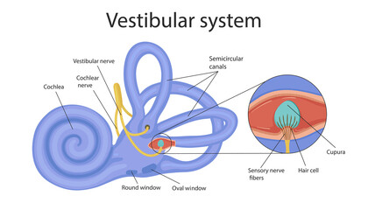
Vestibular system
Located in our inner ear
Our internal ‘spirit level’
Tells us when we are moving, direction and speed
Helps develop posture, balance and coordination

Slide 13
Behaviours you may see
Always ‘on the go’
Reduced co-ordination
Reduced postural control
Prolonged nystagmus
Fearful of movement
Avoidance of playground equipment

Slide 14
Strategies to help
Strategies for the child who is sensitive to movement
Limit unnecessary movements
Slowly introduce different movements into their child's life in safe way
Strategies for the child who craves movement
Ensure they have frequent movement breaks e.g running, cycling
Twirling round on the spot
Touching their toes then looking up to the ceiling
Alternate seating options
Obstacle courses
Rocking toys

Slide 15
Interoception
“The hidden sense”
Helps you understand and feel what's going on inside your body
Nerve receptors are located throughout our bodies including internal organs, bones, muscles and skin
These receptors send information to the brain
Helps you know when you feel thirsty, hungry, need to use the toilet, in pain, breathing rate….
Recognize emotions

Slide 16
Behaviours you may see
Difficulty knowing when they feel:
Hungry/thirsty
Full
Hot/ cold
Ill
Reduced self-regulation
Challenges with toilet training

Slide 17
Strategies to support
Mindfulness
Supporting on increased awareness of body cues
Visuals
Yoga
Breathing exercises

Slide 18
Disclaimer
We all have sensory needs that are unique to us.
Strategies recommended are general however assessment of sensory processing challenges by a qualified Occupational Therapist is recommended.
This will allow strategies to be tailored to your child’s individual needs.

Slide 19
Thank you!
Questions?
Email:
Lucy.griffiths@seashelltrust.org.uk

